Slide 1
Top 10 Favorite Cereals
By: Nathan Cohen

Slide 2
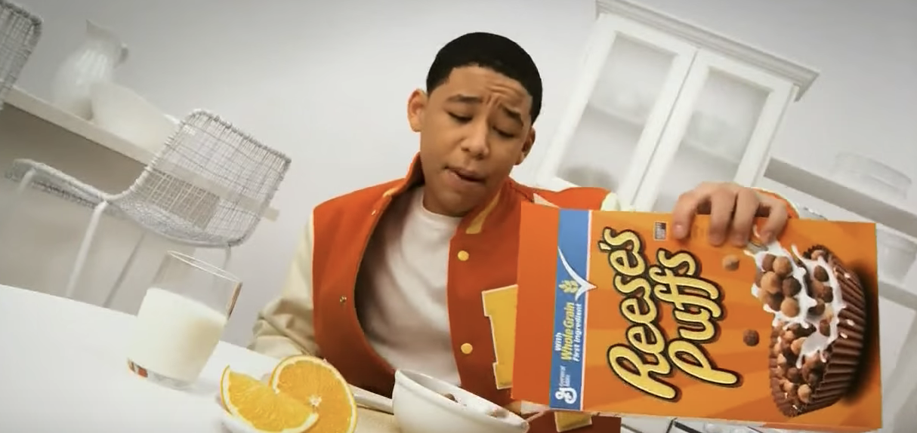
10. REESE’S PUFFS
PEANUT BUTTA CHOCOLATE FLAYVA

Slide 3
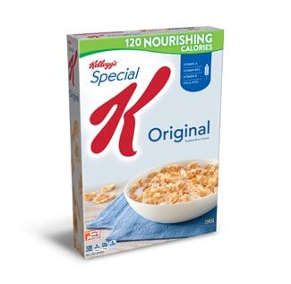
9. Special K
“Hey, what do they do with the Regular K?”
–Peter Griffin

Slide 4
8. Cookie Crisps

Slide 5
7. Cheerios

Slide 6
6. Fruit Rings
Fun Fact: All colors
taste the same

Slide 7
5. Fruit Loops
“Just Follow Your Nose”
-Toucan Sam

Slide 8
4. Honey Nut Cheerios
Over the last decade, more than 30% of the Honey Bee population has disappeared. Honey Bees are dying at an alarming rate.

Slide 9
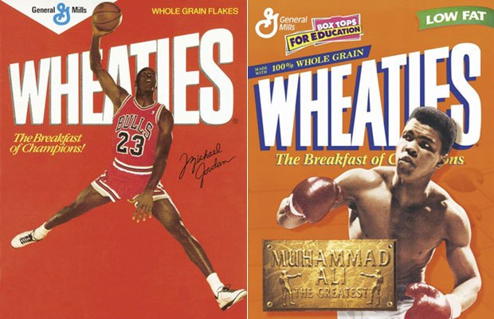
3. Wheaties
“Looks like Nate-Dog didn’t eat his Wheaties this morning!”
–My high school football coach

Slide 10
2. Honey Comb
Over the last decade, more than 30% of the Honey Bee population has disappeared. Honey Bees are dying at an alarming rate.

Slide 11
1. Frosted Flakes
Why you may ask?
Because
“They’re GR-R-REAT!”

